Slide 1
Predicting Student Grades
Sherlin Whaley
Certified Data Scientist

Slide 2
Why Education?
Student grades serve as a marker to determine a student’s progress and their concept mastery level.
Concept mastery is important because it is the indicator by which someone has learned a new skill, trade or concept.
Failing students, generally, have been deemed to not have learned a concept well enough to be able to complete that task with at least 70% accuracy.

Slide 3
Trends in Education for the UK & US
While 91% of students graduate High School in the U.K., 77% of students graduate in the U.S.
The UK is ranked as low as 26th, out of 32, for the number of teenagers opting to remain in education up to the age of 19.
The UK separates school by four stages:
Stage 1 – ages 5 – 6
Stage 2 – ages 7 – 10
Stage 3 – ages 11 – 13
Stage 4 – ages 14 – 15

Slide 4
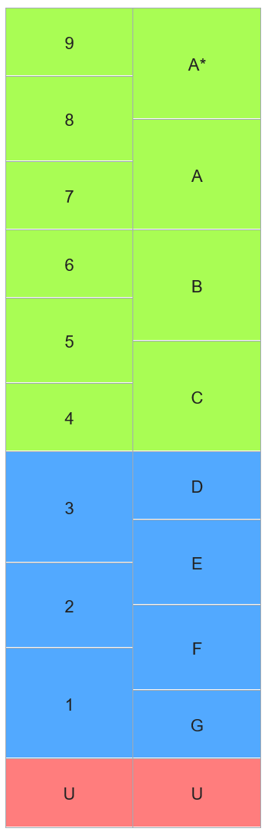
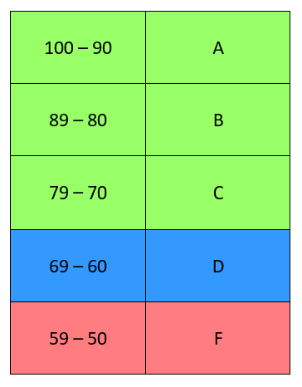
UK Grades Vs. US Grades
Grades in the UK
Grades in the US

Slide 5
Mission Statement/Goals
To provide schools and districts with an optimal view of their student’s data.
To objectively come to relevant and insightful conclusions based on the data.

Slide 6
Methods
Data Source: Kaggle.com
Data Content: Student Grades from the UK
Sample Size: 1037 rows, 20 columns
Analyses Performed:
Linear Regressions 1 & 2
Random Forest
Step-wise Regression
Basic ANOVAs 1, 2 & 3

Slide 7
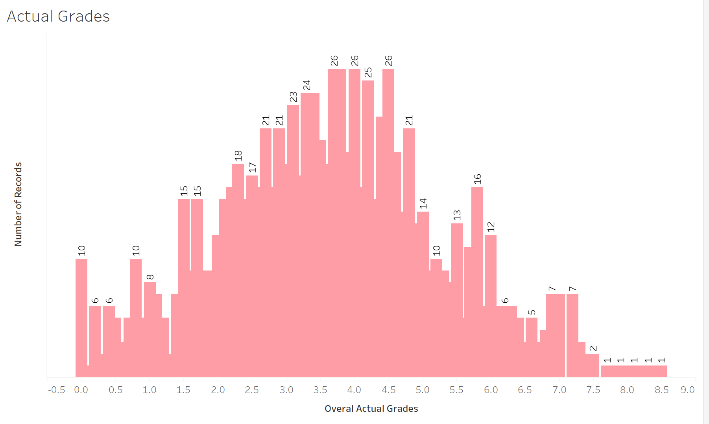
Overall Average of All Earned Grades

Slide 8
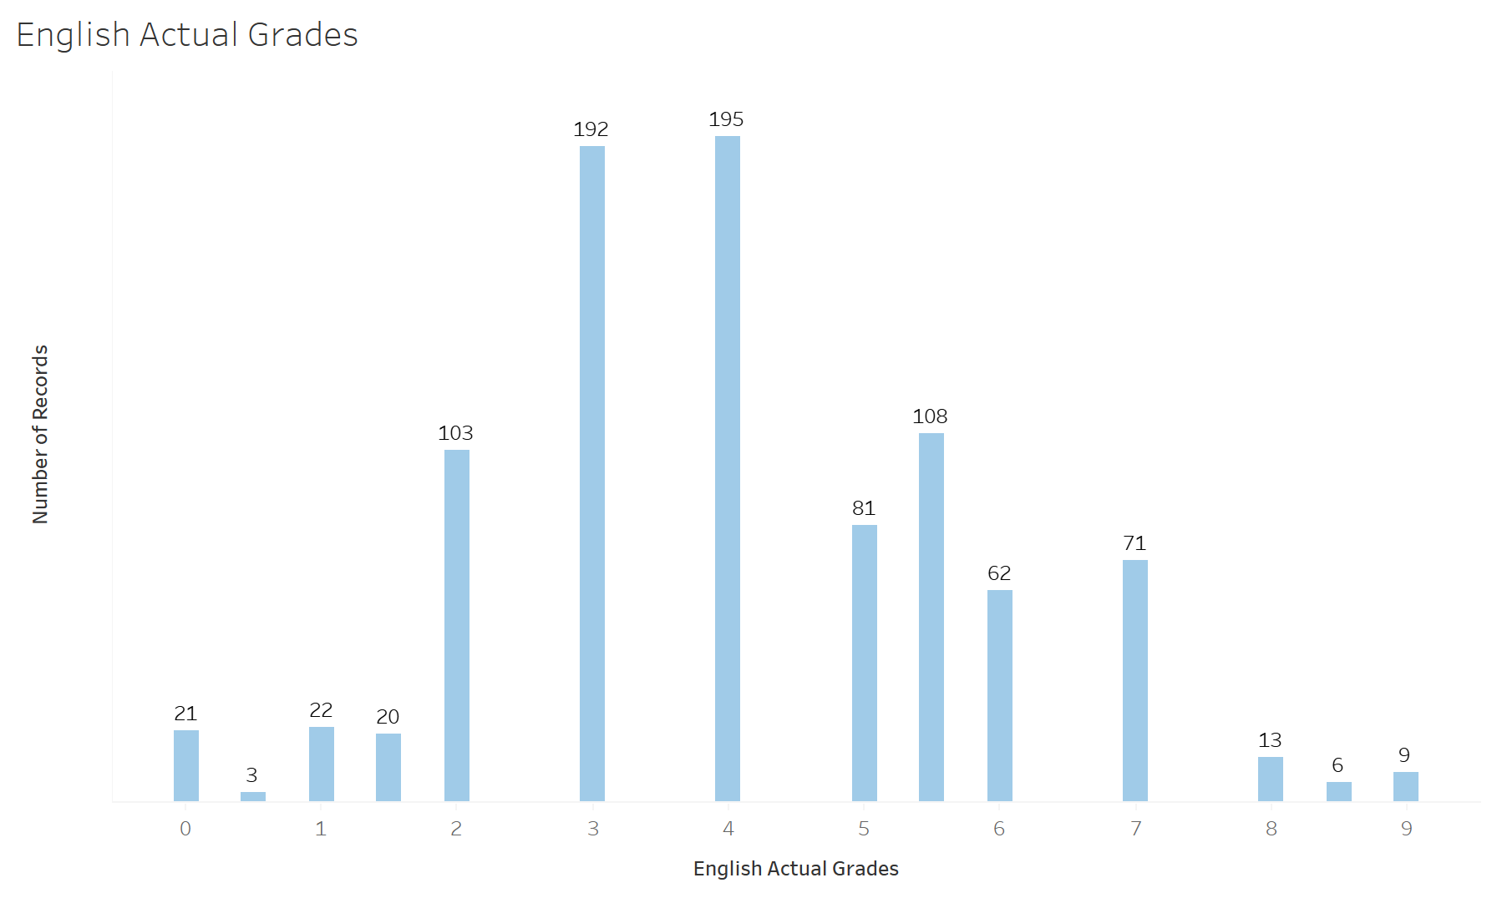
English Earned Grades

Slide 9
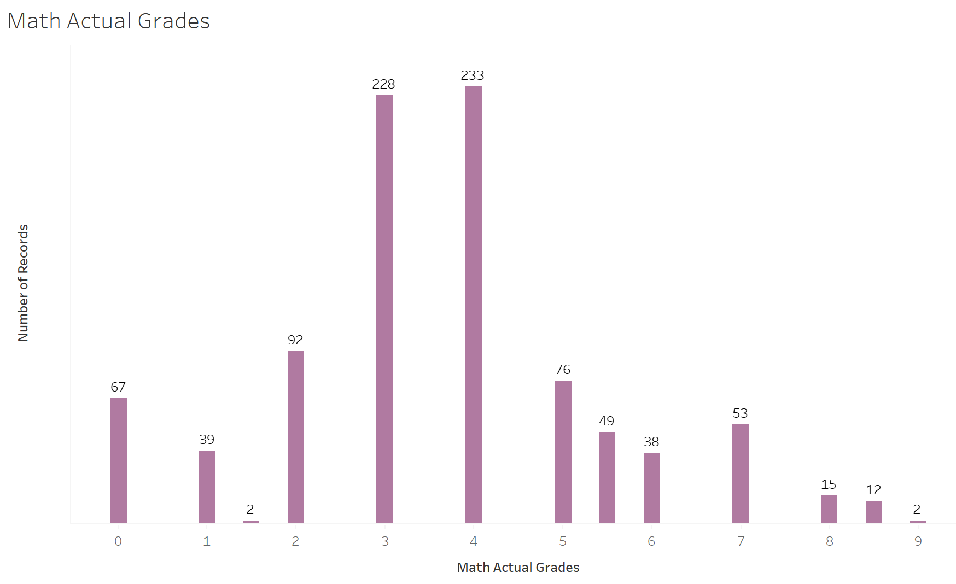
Math Earned Grades

Slide 10
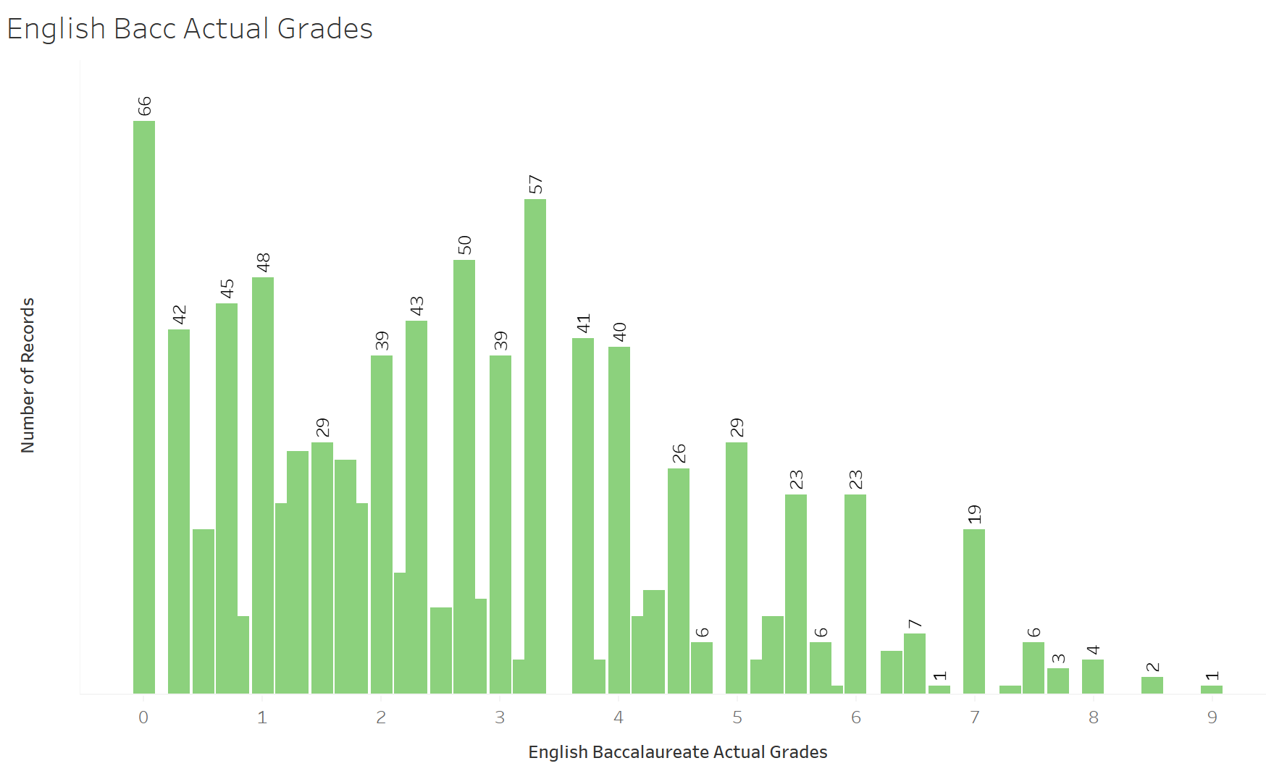
English Baccalaureate Earned Grades

Slide 11
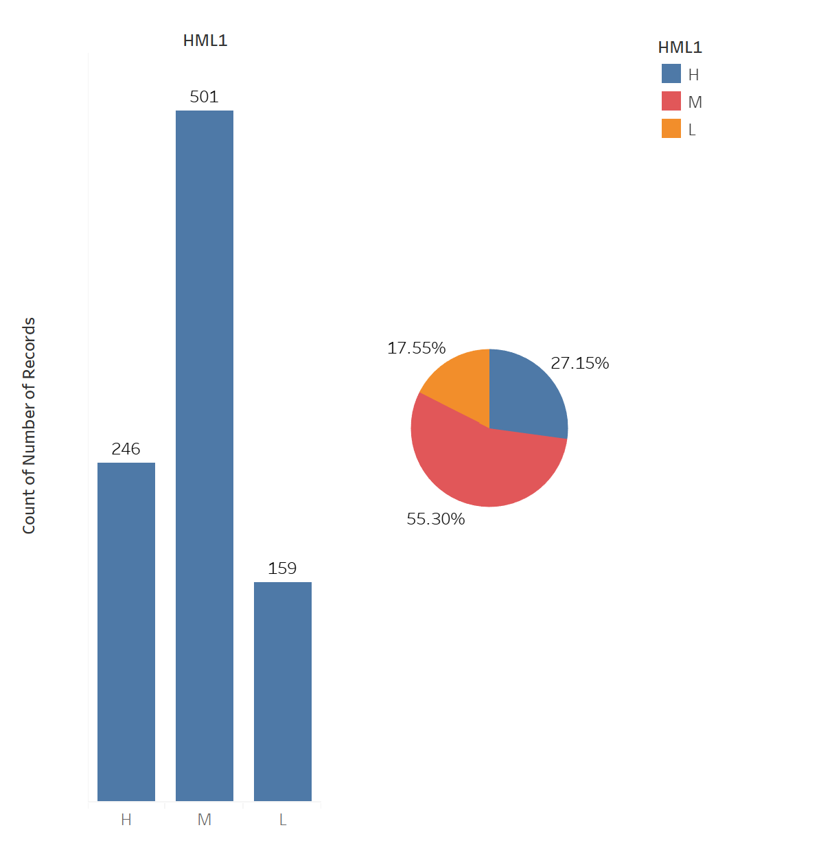
Students by Learner Level High – Medium - Low

Slide 12
Special Educational Needs Data

Slide 13
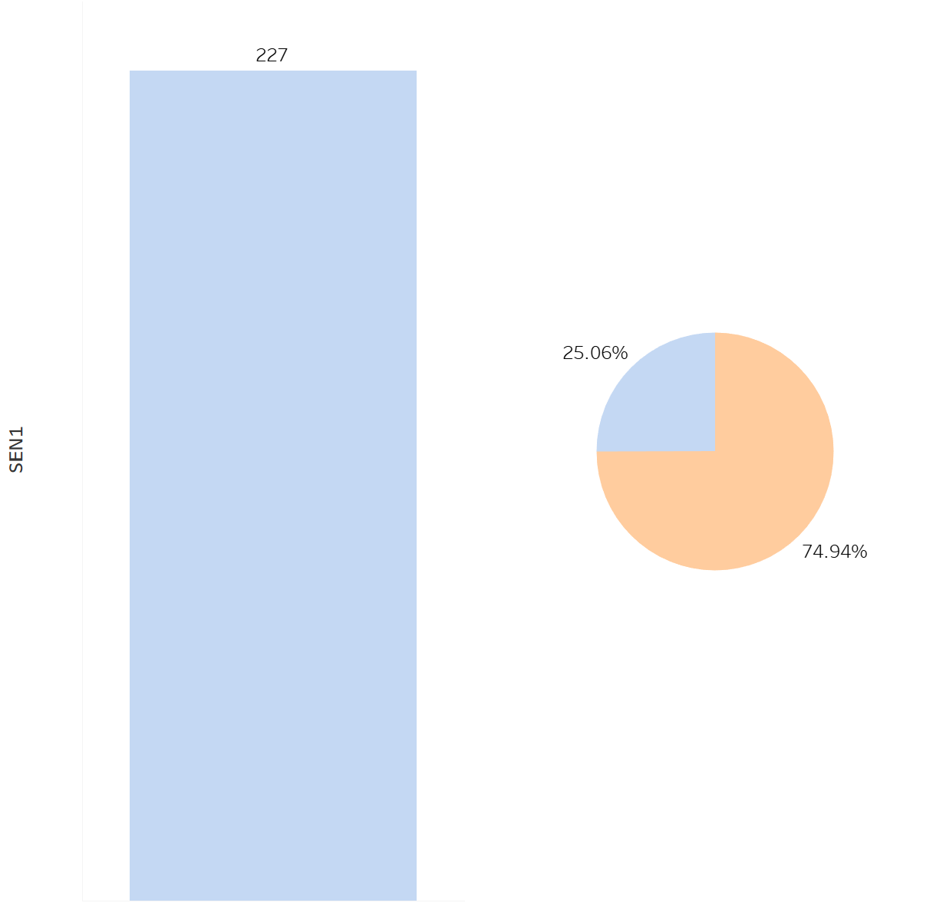
Students with Special Educational Needs (SEN)
SEN Students
Students without SENs

Slide 14
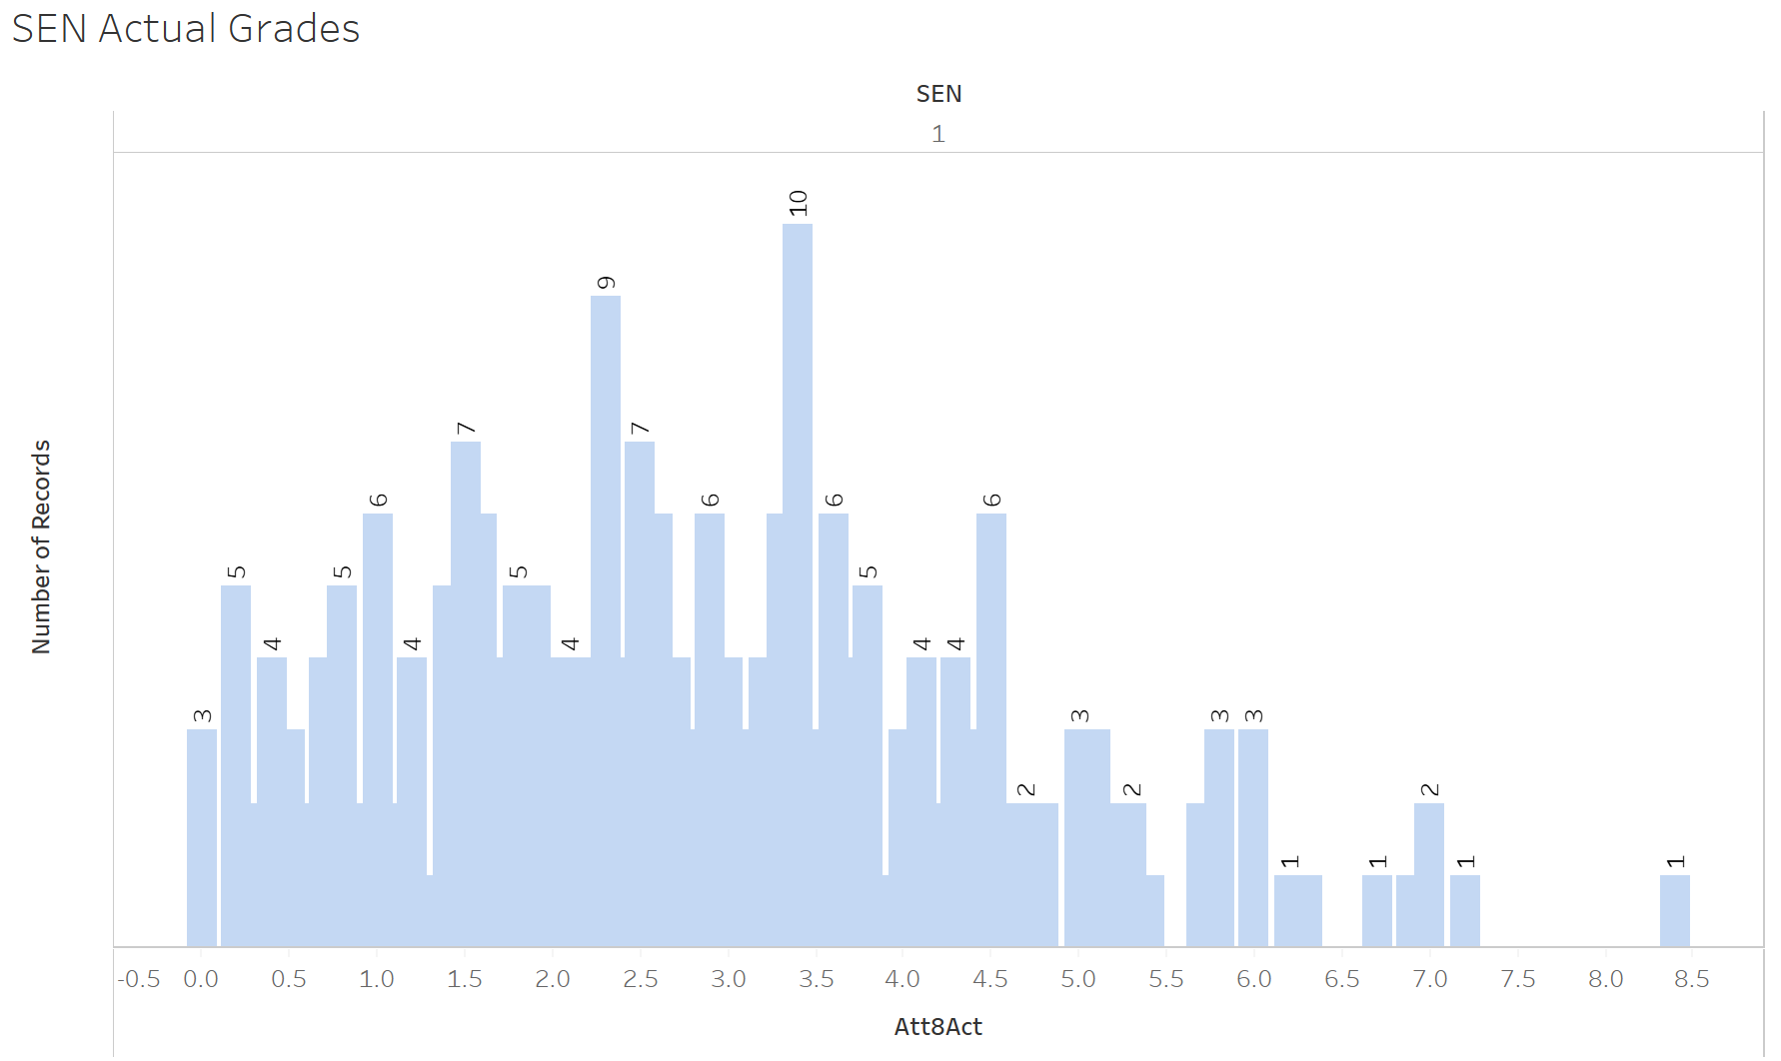
SEN Actual Grades

Slide 15
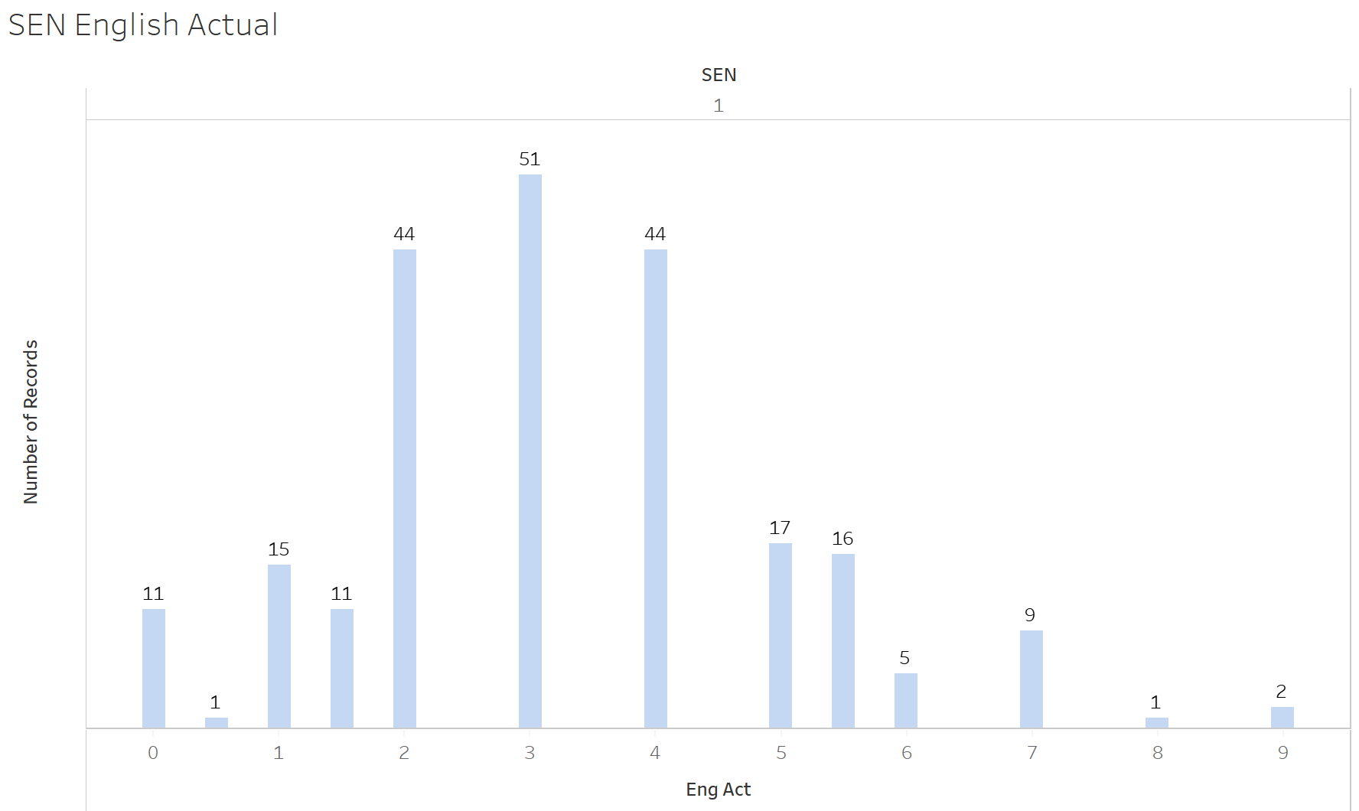
SEN English Grades

Slide 16
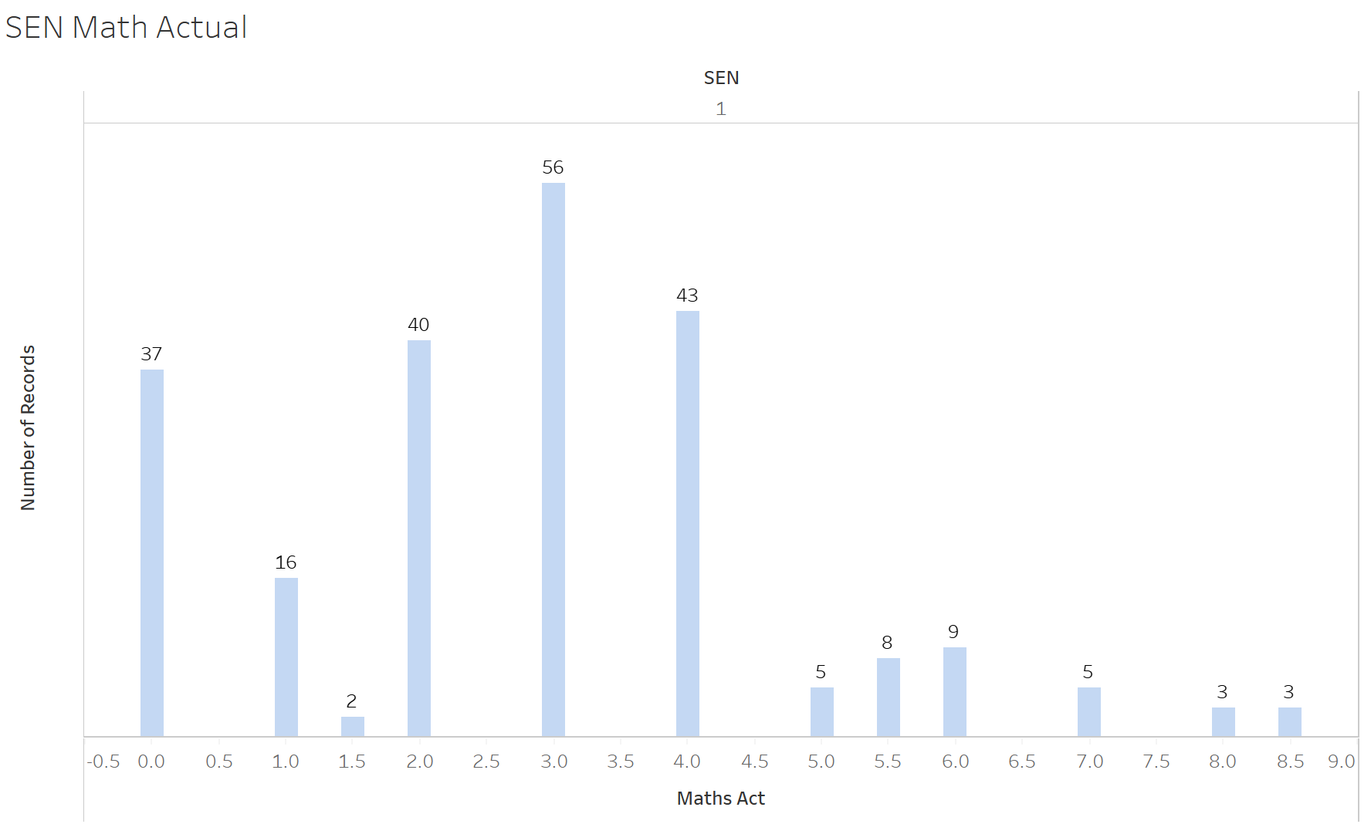
SEN Math Grades

Slide 17
Students with English as a Second Language

Slide 18
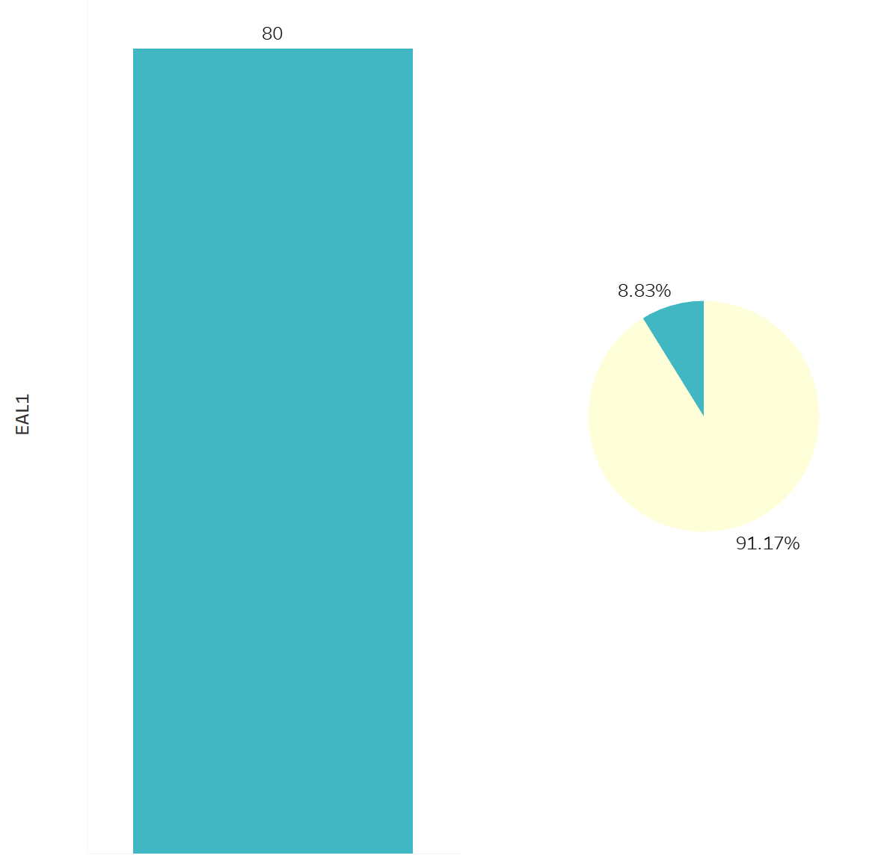
Students with English as a Second Language (EAL)
Students with English as a second Language
Students without English as a Second Language

Slide 19
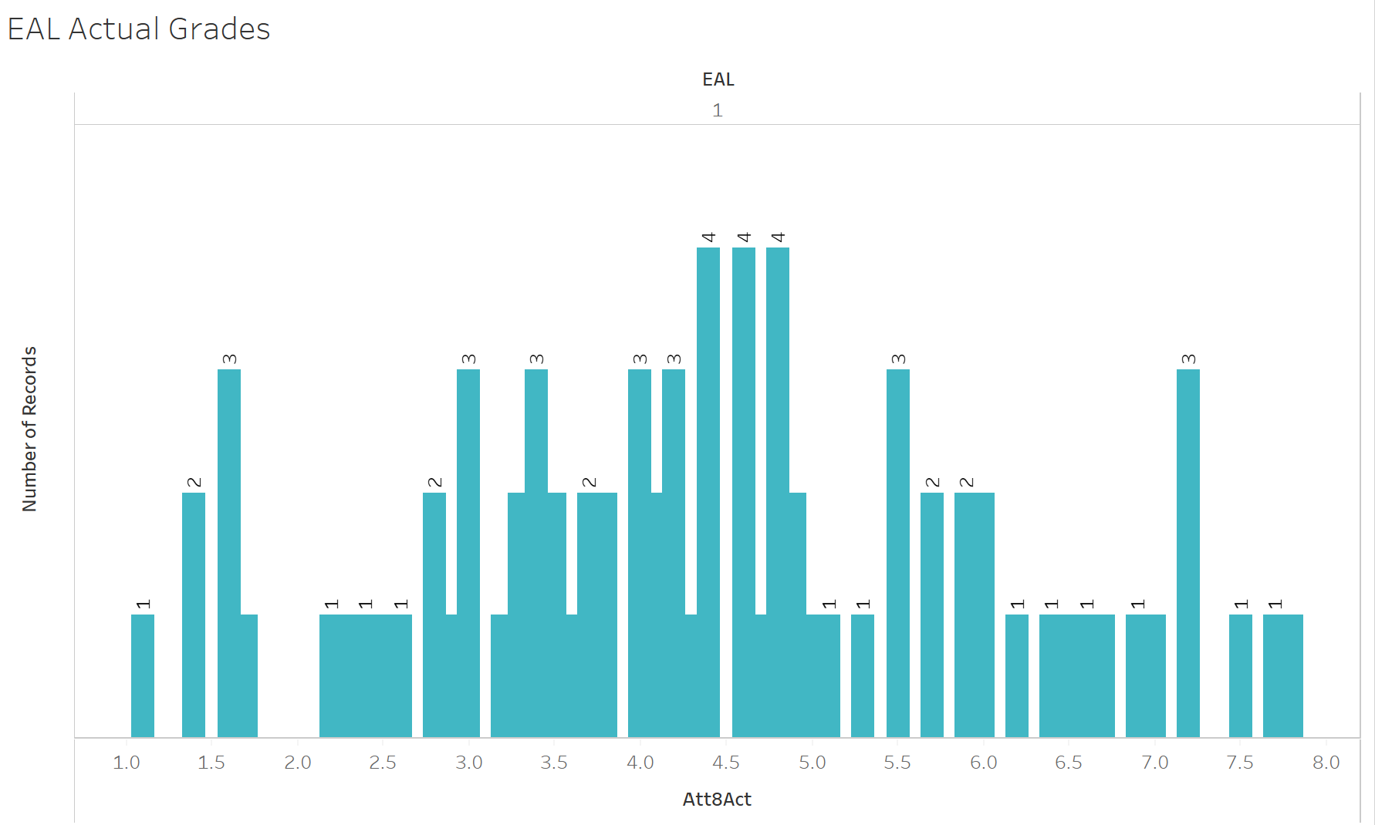
EAL Actual Grades

Slide 20
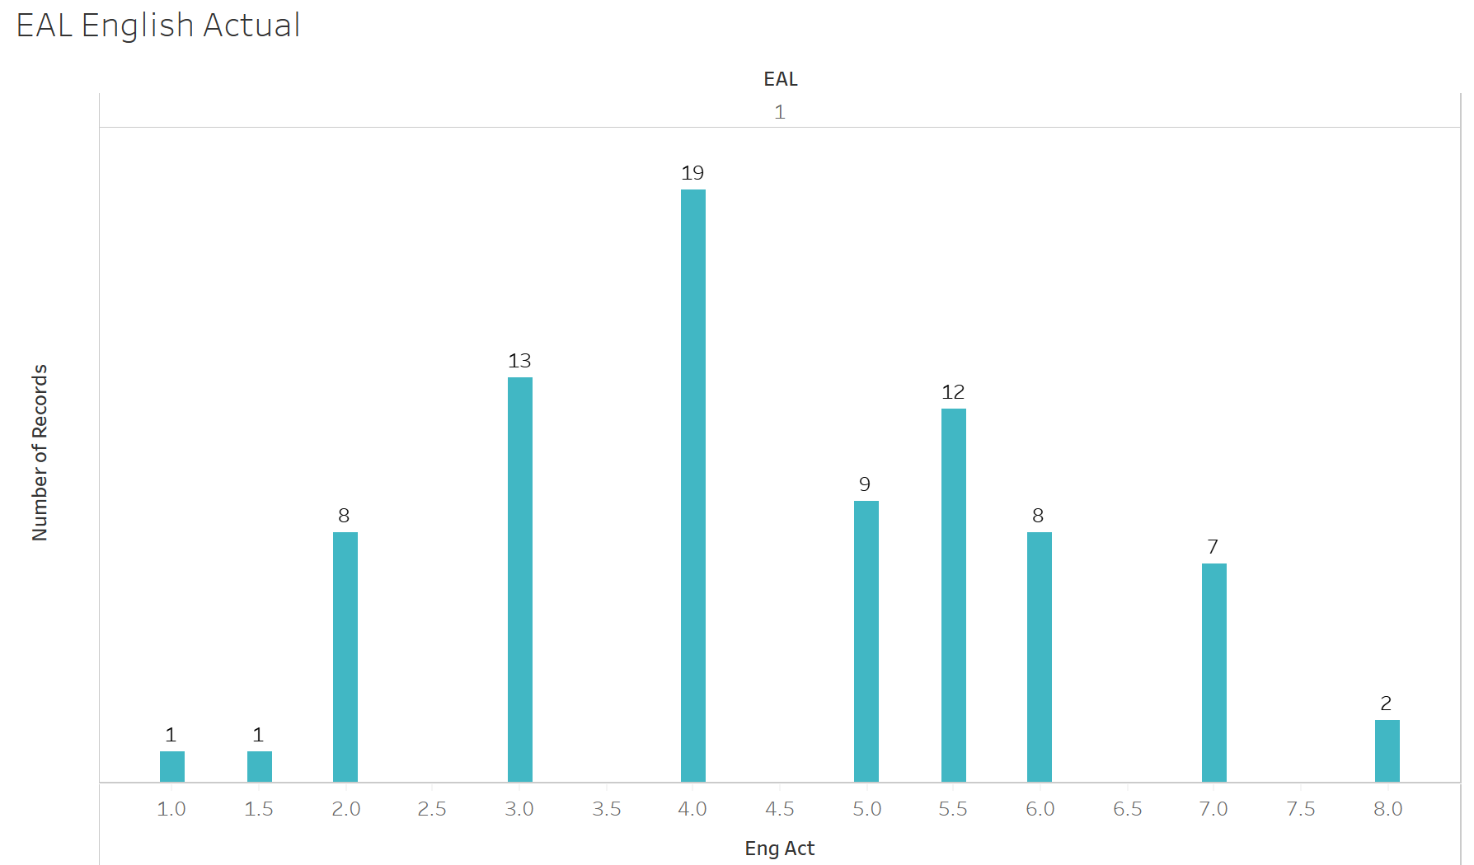
EAL English Grades

Slide 21
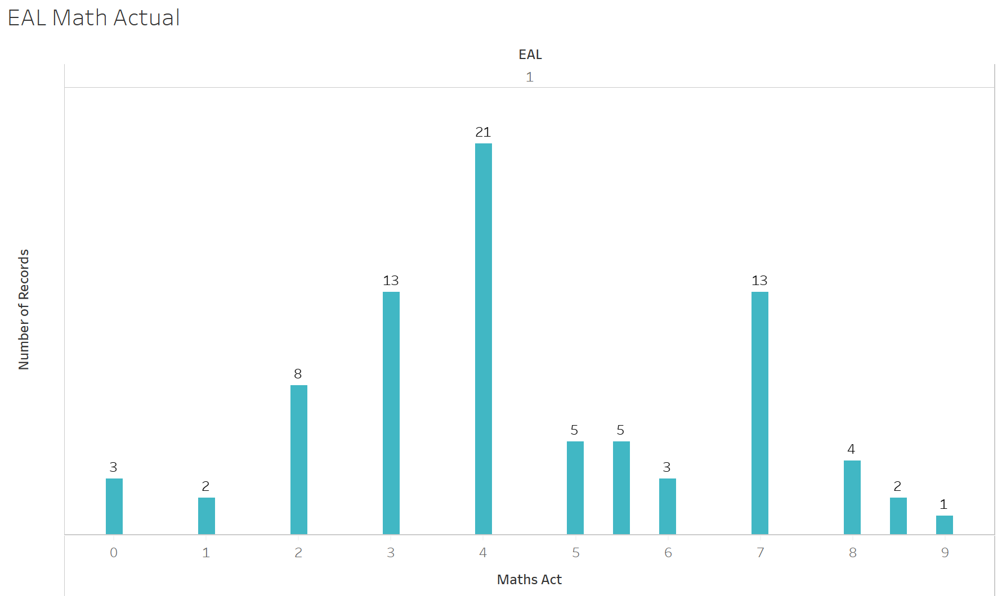
EAL Math Grades

Slide 22
Students with Pupil Premium Funding

Slide 23
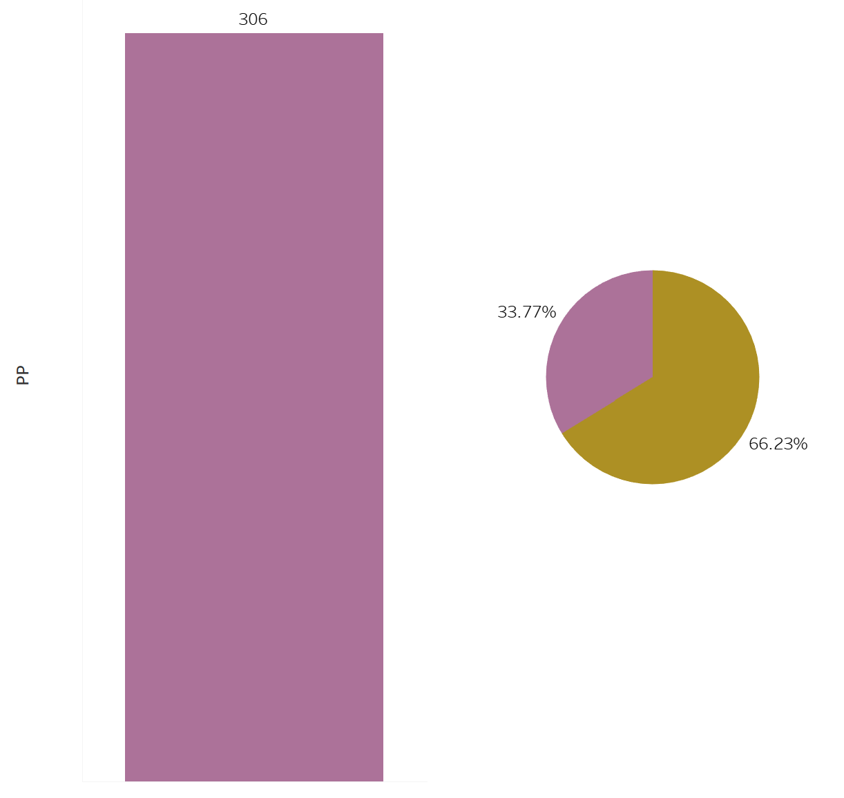
Students that Receive Pupil Premium (PP) Funding
Students with Pupil Premium
Students without Pupil Premium

Slide 24
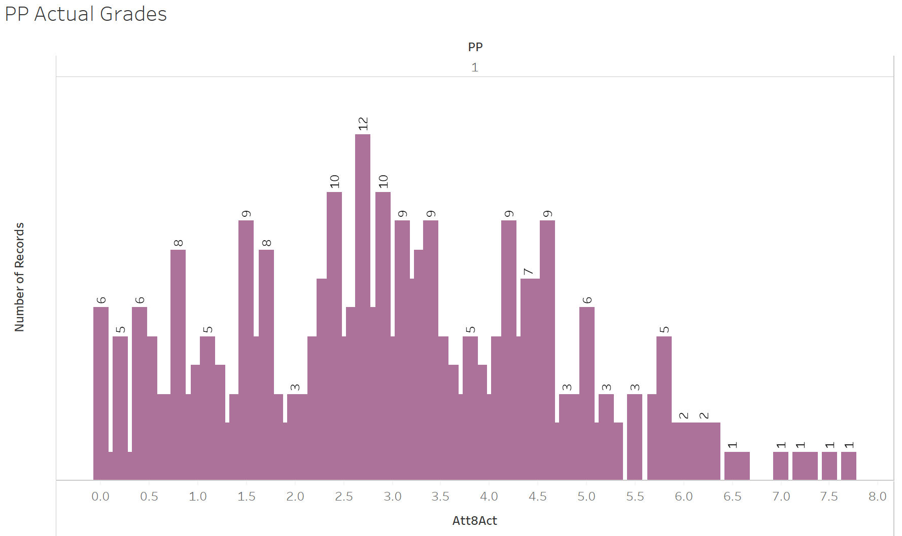
PP Actual Grades

Slide 25
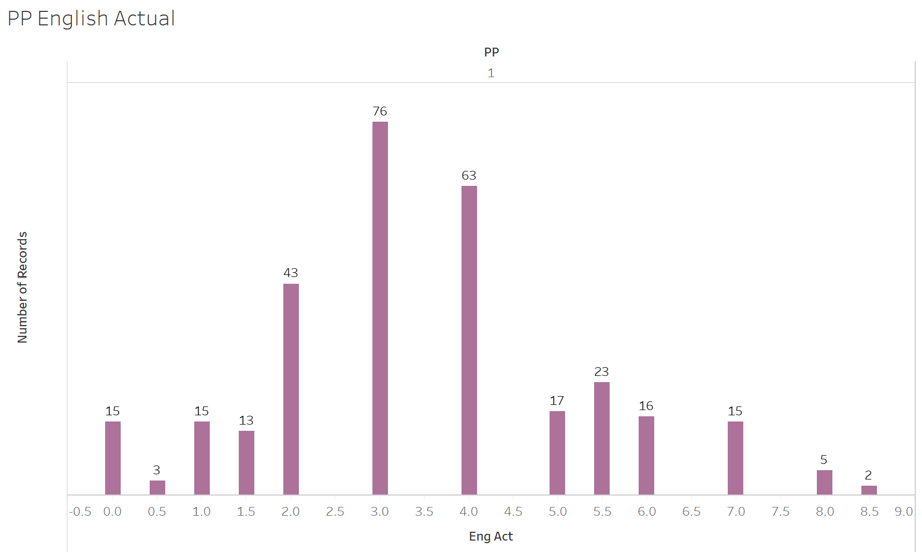
PP English Grades

Slide 26
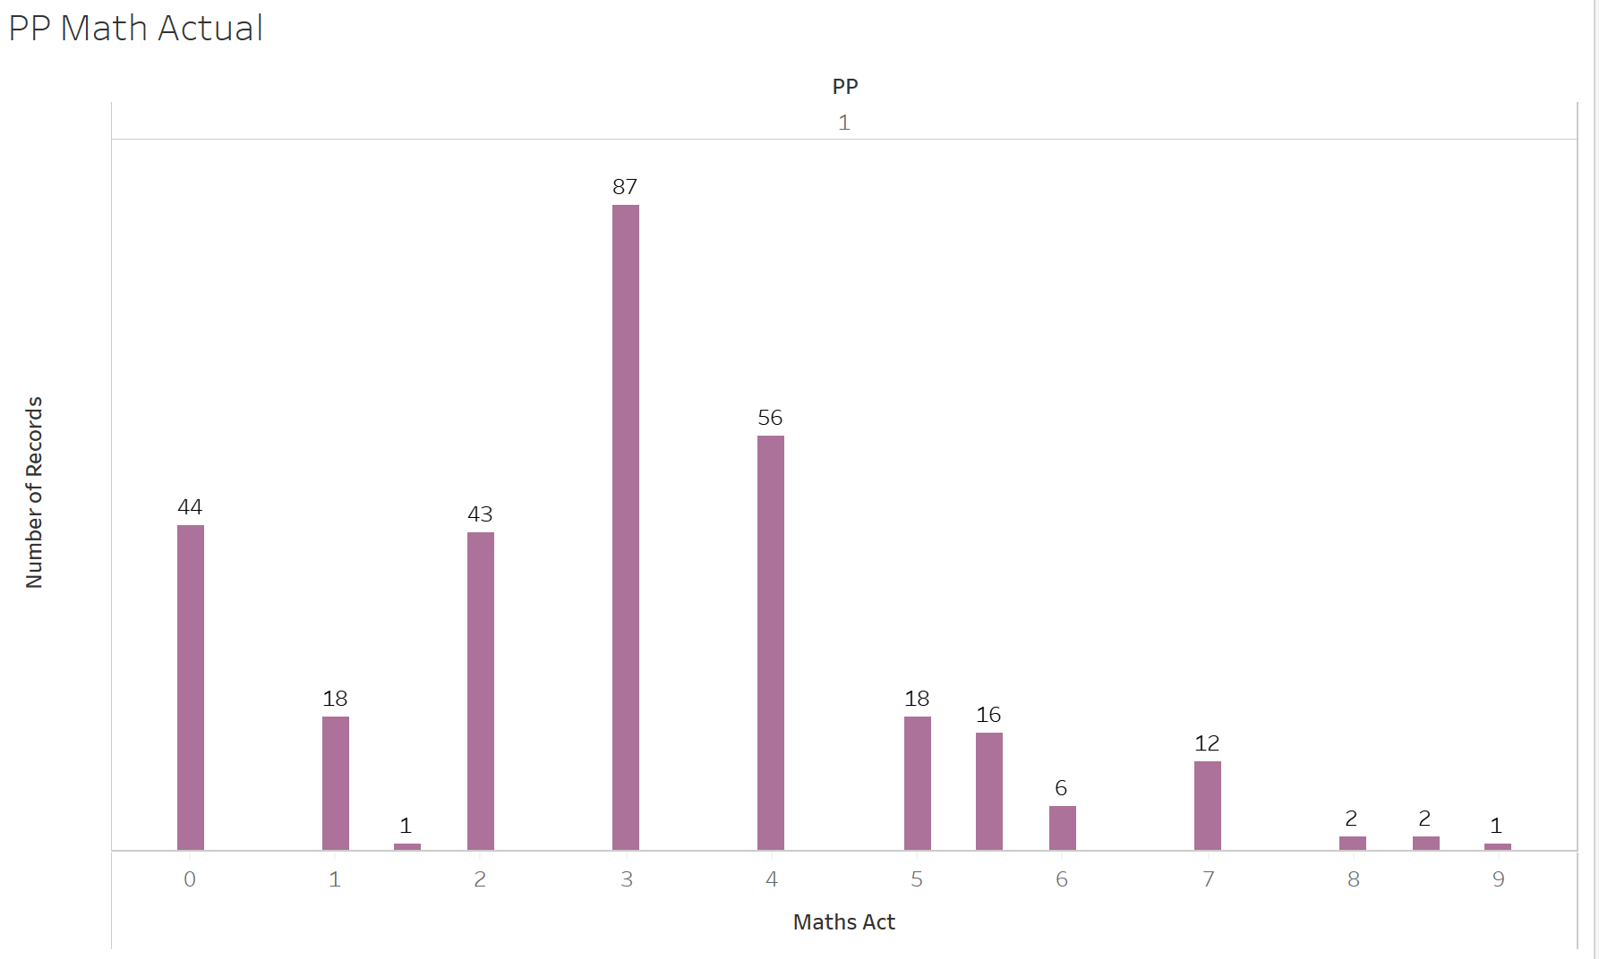
PP Math Grades

Slide 27
Summary
This dataset showed that there was a significance between the students that received the pupil premium, students with special educational needs and students with English as a second language and their grades.
The dataset also was able to have the student’s grades predicted with 98.9% accuracy.
Students within the subpopulations of special educational needs, English as a second language and pupil premium generally score 1 grade lower than their peers without the given subpopulation titles.
Over 50% of students with English as a second language scored a 4 (grade of a D) or lower in English.
81% of students with pupil premium funding scored a 4 or lower in math.

Slide 28
Conclusion
Overall, this analysis will help teachers and administrators predict student grades and help their potential areas of weaknesses.
It will also allow them to see students’ strengths and areas with which do not need further learning assistance.
Students within the sub-populations show that they need more focus due to lower scores.
This process and machine learning is a great tool that won’t replace students earning their actual grades. However, it will enhance the viewpoint of teachers and administrators to be able to further assist students.

Slide 29
Credits
https://sundial.csun.edu/43544/opinions/the-u-k-school-system-vs-the-u-s-school-system-why-we%E2%80%99re-losing/

